Slide 1
Containment, Recovery and Salvage Considerations
CGPRT(W) : Ensuring Clean Seas and Coasts in Western Region ……

Slide 2
Objective
To provide a short introduction to containment
To consider how containment may be used as an operational tactic
To provide a short introduction to recovery
To consider how recovery may be used as an operational tactic
To provide a short introduction to salvage operations and some general salvage techniques
To consider some Place of Refuge considerations and how they are applied within the incident response
To consider how salvage operations can be integrated within the Incident Command
CGPRT(W) : Ensuring Clean Seas and Coasts in Western Region ……

Slide 3
Containment
CGPRT(W) : Ensuring Clean Seas and Coasts in Western Region ……

Slide 4
Containment
Containment objectives include:
To prevent the initial discharge from spreading, if used promptly
To prevent both continuous and further discharges from spreading
To corral and thicken oil for recovery or burning
To protect sensitive resources and environments
To deflect a spreading slick away from sensitive resources and habitats
To deflect a spreading slick to areas from which it can be more easily recovered
CGPRT(W) : Ensuring Clean Seas and Coasts in Western Region ……

Slide 5
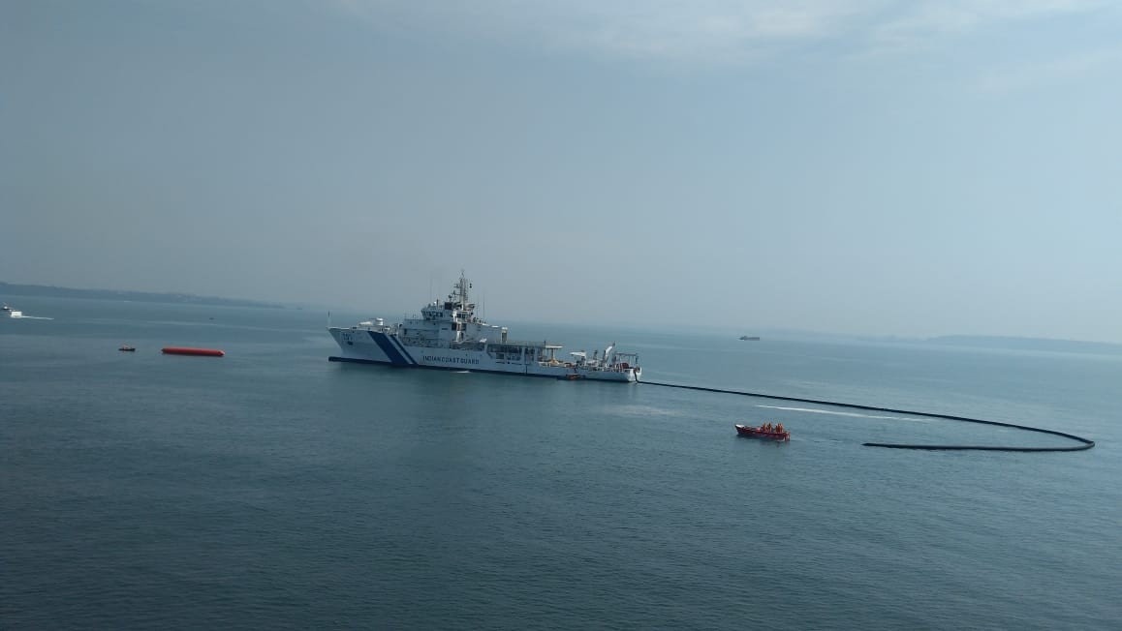
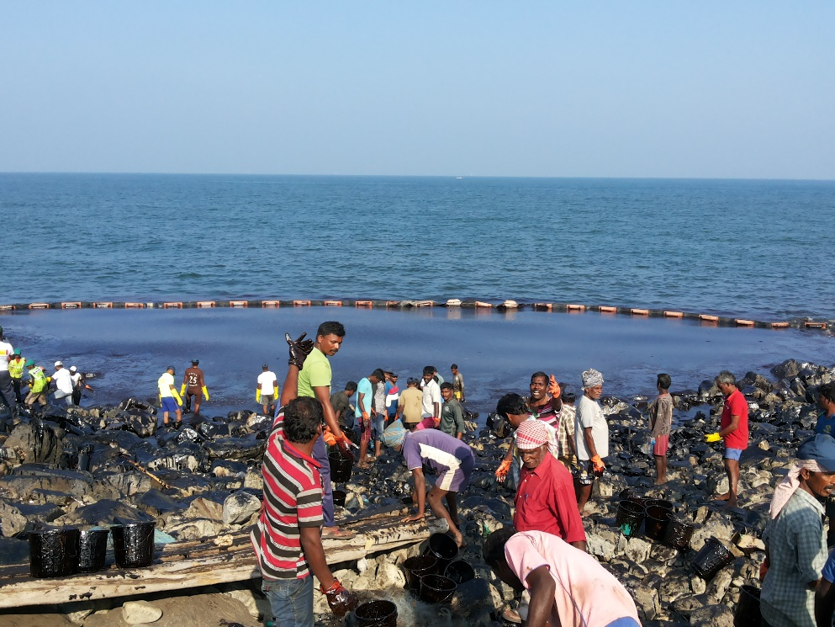
Containment
CGPRT(W) : Ensuring Clean Seas and Coasts in Western Region ……

Slide 6
Containment
Each objective requires careful planning, selection and deployment of resources
Close cooperation between Operations, Planning and Logistics functions
Command Function
Planning Function
Logistics
Function
Finance Function
Operations Function
Response
Planning
Booming
Operations
At-Sea Recovery
Near-shore Containment
Resource Deployment
CGPRT(W) : Ensuring Clean Seas and Coasts in Western Region ……

Slide 7
Boom Selection
Different types of boom are designed for specific operating environments and purposes:
Rapid deployment
In ports, marinas, offshore installations
Calm and sheltered waters
Ports, etc.
Shoreline sealing
Tidal conditions
In situ burning
Open water
CGPRT(W) : Ensuring Clean Seas and Coasts in Western Region ……

Slide 8
Boom Selection
The selection of boom types and sizes will be dependent on:
The planned deployment purpose
The proposed location
Calm water, low current, open water
The deployment platform
The following factors need to be considered:
The environmental conditions
Wind, waves, tide/current
The buoyancy/weight ratio of the selected boom
CGPRT(W) : Ensuring Clean Seas and Coasts in Western Region ……

Slide 9
Boom Types
Many different types of booms but generally they fall into four main groups:
Curtain-type boom
Generally have distinct buoyancy chambers and a skirt
Include solid flotation, air-inflatable and self-inflatable
Fence boom
Includes standard fence and external tension member booms
Shore-seal boom
Fire-proof boom (refer to module on ISB)
CGPRT(W) : Ensuring Clean Seas and Coasts in Western Region ……

Slide 10
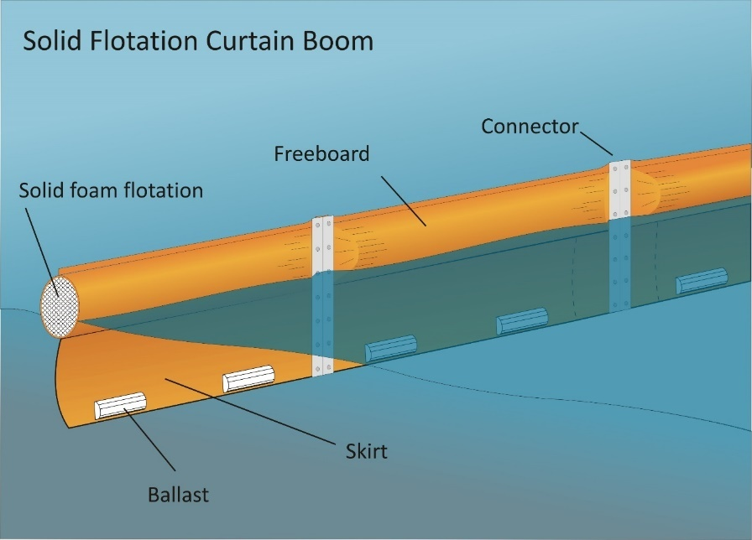
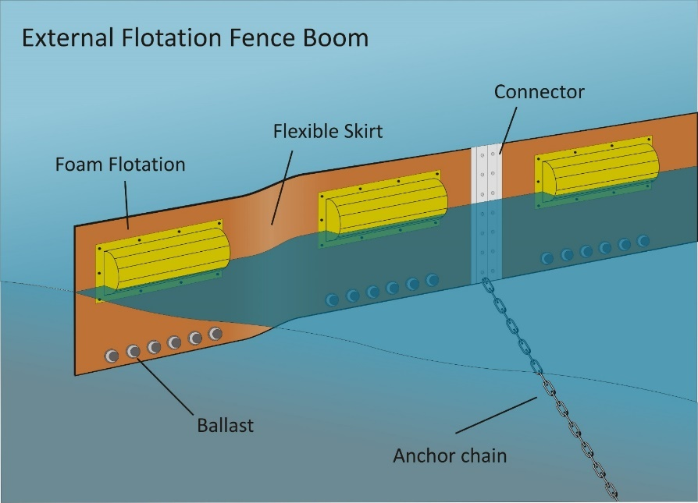
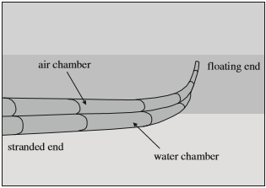
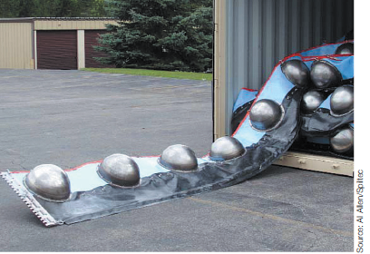
Boom Types
Source : ITOPF
Source : ITOPF
Source: ExxonMobil
CGPRT(W) : Ensuring Clean Seas and Coasts in Western Region ……

Slide 11
Alternative Barriers
There are a number of other boom types that do not fall into the main categories described:
Pneumatic barriers
Employing a screen of air bubbles released below the water surface
Net booms
Designed primarily to contain viscous oils
Makeshift/improvised barriers
Created locally from readily available materials
Consider what material and designs may be available locally during the planning process
CGPRT(W) : Ensuring Clean Seas and Coasts in Western Region ……

Slide 12
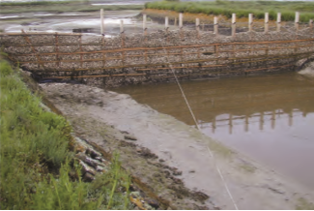
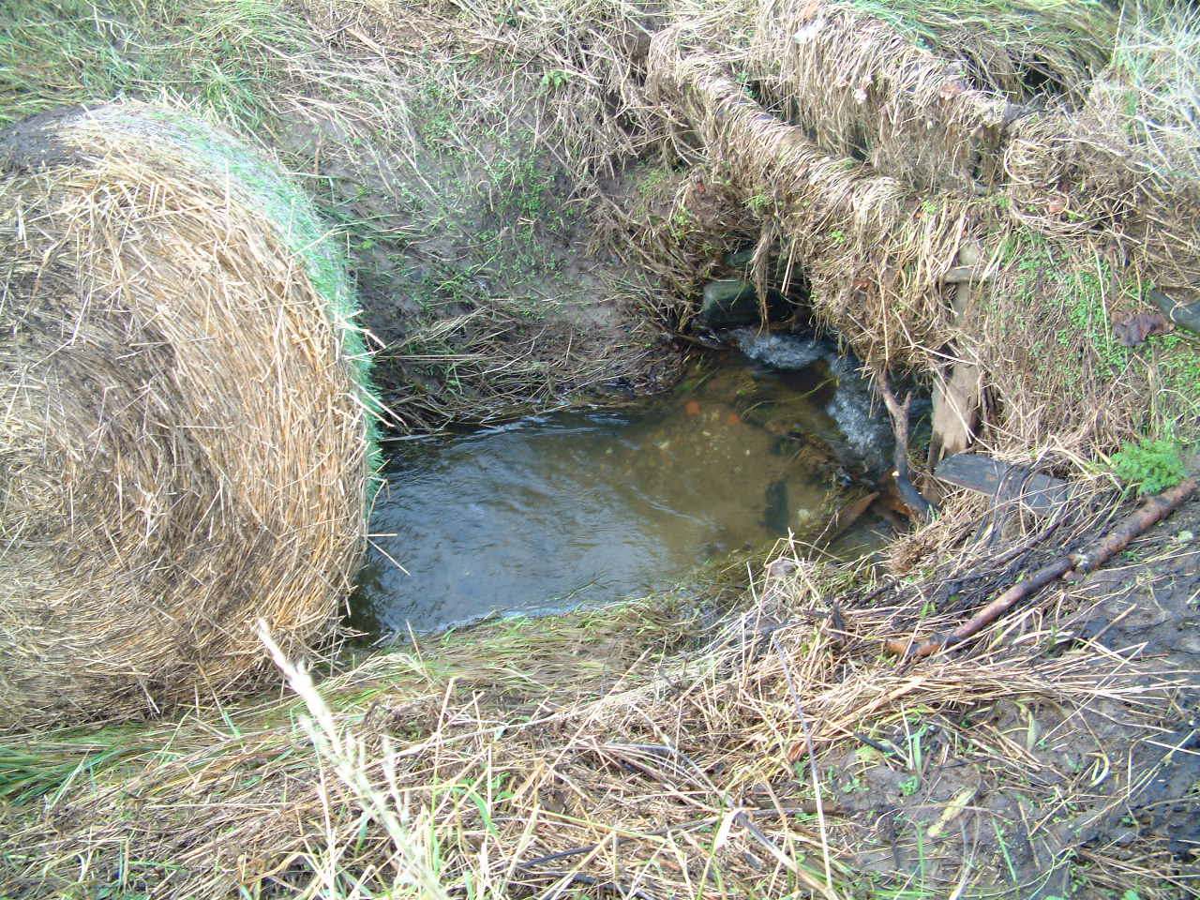

Alternative Barriers
Source : ITOPF
Oyster shells
Straw bales
CGPRT(W) : Ensuring Clean Seas and Coasts in Western Region ……

Slide 13
Boom Selection Criteria
 | Calm Water | Calm Water Current | Protected Water | Open Water | Open Rough Water
Wave Height (m) | < 0.3 | < 0.3 | 0 – 1.0 | 0 – 2.0 | > 2
Conditions | Small short non-breaking waves | Currents of 0.4 m/s or greater | Small waves and some white caps | Moderate waves and frequent white caps | Large waves, foam crests and some spray
Suitable boom type or group | Curtain Fence | Curtain with freeboard of 50% of boom height Fence | Curtain Fence | Curtain Fence with external tension support | Curtain
Boom Height (mm) | 150 - 600 | 200 - 600 | 450 – 1,100 | 900 – 2,300 | 1,500+
Buoyancy-to-weight ratio | 3:1 | 4:1 | 4:1 | 8:1 | 8:1
Minimum tensile strength of boom (Newtons) | 6,800 | 23,000 | 23,000 | 45,000 | 45,000+
CGPRT(W) : Ensuring Clean Seas and Coasts in Western Region ……

Slide 14
Boom Limitations and Failures
Booms may fail operationally in one of five main modes:
Entrainment
Drainage
Splash over
Submergence
Planning failure
These failures are covered in greater detail in the Level 1 course
Containment systems typically have a relatively low oil-encounter rate and their operation in rougher seas may be ineffective and raise serious safety concerns
CGPRT(W) : Ensuring Clean Seas and Coasts in Western Region ……

Slide 15
Boom Limitations and Failures
Boom may also suffer structural failure when placed under stress. This is normally associated with boom deployment outside their design limits.
Containment operations, like all other tactical options, must be technically reasonable, preferably planned in advance, and conducted in a safe manner within the design limits of the equipment.
CGPRT(W) : Ensuring Clean Seas and Coasts in Western Region ……

Slide 16
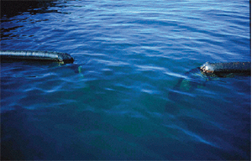
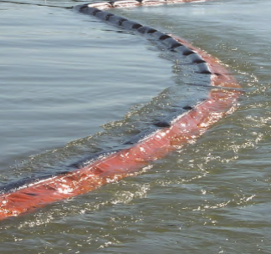
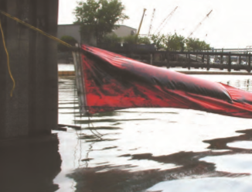
Boom Limitations and Failures
Source: OSRL
Source: ITOPF
Source: ITOPF
CGPRT(W) : Ensuring Clean Seas and Coasts in Western Region ……

Slide 17
Containing at-Source
Containing a spill from a fixed source such as a vessel alongside a jetty or aground requires careful planning
The advantages/disadvantages of this option must be considered:
Do the environmental advantages outweigh any safety considerations?
The type of oil being released and the sensitivity are the key factors in this decision
CGPRT(W) : Ensuring Clean Seas and Coasts in Western Region ……

Slide 18
Containment
This table provides some general planning guidance on boom lengths for different protection applications:
Application | Quantity of Boom
Encircling a stricken vessel | 3 x ship’s length
Containment of an operational spill from a vessel at a terminal | 1.5 x ship’s length plus distance from bow and stern to shore
Protection of an entrance to an estuary, stream, river, etc. | 3−4 x width of the body of water
General booming in bays and harbours | 1.5+ current in knots x width of water body
CGPRT(W) : Ensuring Clean Seas and Coasts in Western Region ……

Slide 19
Tactical Considerations − Booms
In summary:
Is it technically reasonable?
Does it meet our NEBA criteria and considerations?
Is it allowed under our regulations?
Do we have the resources?
Can we monitor the effectiveness?
Note: Risk assessment of current and expected conditions in addition to NEBA
CGPRT(W) : Ensuring Clean Seas and Coasts in Western Region ……

Slide 20
Protection and Containment Plans
Protection Plan
Things to consider
What sites do you want to protect?
How much boom is available?
Do you have sufficient ancillaries such as anchors, ropes, buoys?
Do logistical considerations allow for boom deployment to sites?
Does time permit boom deployment prior to oil reaching site?
If limited boom is available, boom should be deployed to sites as prioritized.
CGPRT(W) : Ensuring Clean Seas and Coasts in Western Region ……

Slide 21
Protection and Containment Plans
Containment Plan
Things to consider:
Type of oil
Can it be contained?
Trajectory – Where is it headed?
Locations where containment is feasible
Shorelines
Can booms be deployed?
Places to anchor boom
How much boom is needed to contain oil in location
Is sufficient boom available?
Are boats available to deploy boom?
Are personnel available to deploy and maintain boom?
CGPRT(W) : Ensuring Clean Seas and Coasts in Western Region ……

Slide 22
Protection and Containment Plans
Containment Plan
Ongoing plan adjustment
Monitor path of oil to determine where changes in strategy are necessary
Use modelling trajectories and observation throughout response
When window of opportunity for alternative response mechanisms (dispersants, ISB, bioremediation) has passed, have a back-up plan for containment and recovery
When oil comes ashore, implement shoreline clean-up plan
Meet regularly to monitor status of clean-up operations
If not enough personnel and equipment are available, prioritize strategies for response operations
CGPRT(W) : Ensuring Clean Seas and Coasts in Western Region ……

Slide 23
On Completion
Consideration should be given to:
Determining when the boom should be removed or redeployed elsewhere
What resources are required to recover the boom
How and where the boom will be cleaned before being redeployed or returned
The organization of the temporary cleaning area, including any permits and provision of personnel and materials
The recovery, capture and disposal of any waste
CGPRT(W) : Ensuring Clean Seas and Coasts in Western Region ……

Slide 24
Recovery
CGPRT(W) : Ensuring Clean Seas and Coasts in Western Region ……

Slide 25
Recovery Operations
Recovery objectives include:
Physically recovering the oil from the water surface
Minimizing any further damage to marine resources and the environment
Reducing the amount of oil that may impact the shoreline
Recovering floating oil from shoreline clean-up operations
CGPRT(W) : Ensuring Clean Seas and Coasts in Western Region ……

Slide 26
Recovery Operations
Each objective requires careful planning, selection and deployment of resources
Close cooperation between Operations, Planning and Logistics functions
Command Function
Planning Function
Logistics
Function
Finance Function
Operations Function
Response
Planning
At-Sea Recovery
Near-Sea Recovery
Resource Deployment
CGPRT(W) : Ensuring Clean Seas and Coasts in Western Region ……

Slide 27
Tactical Considerations − Recovery
In summary:
Is it technically reasonable?
Does it meet our NEBA criteria and considerations?
Is it allowed under our regulations?
Do we have the resources?
Can we monitor the effectiveness?
Note: Risk assessment of current and expected conditions in addition to NEBA
CGPRT(W) : Ensuring Clean Seas and Coasts in Western Region ……

Slide 28
Recovery Devices
Different types and sizes of recovery devices are designed for specific operating environments and different types of oil:
Light to medium oils in sheltered waters
Ports, marinas, rivers and estuaries
Light to medium oils in open waters
Open waters, offshore
Heavy oils in sheltered waters
In ports, rivers and estuaries
Heavy oils in open waters
Open waters, offshore
CGPRT(W) : Ensuring Clean Seas and Coasts in Western Region ……

Slide 29
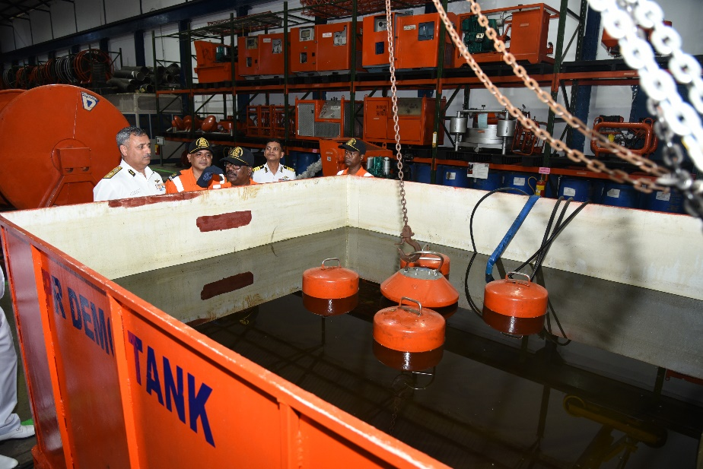
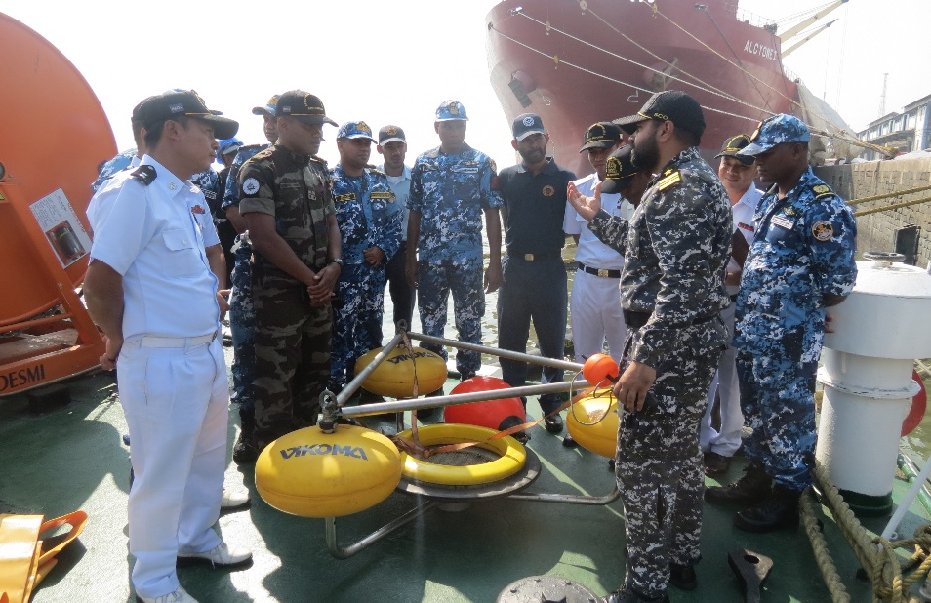
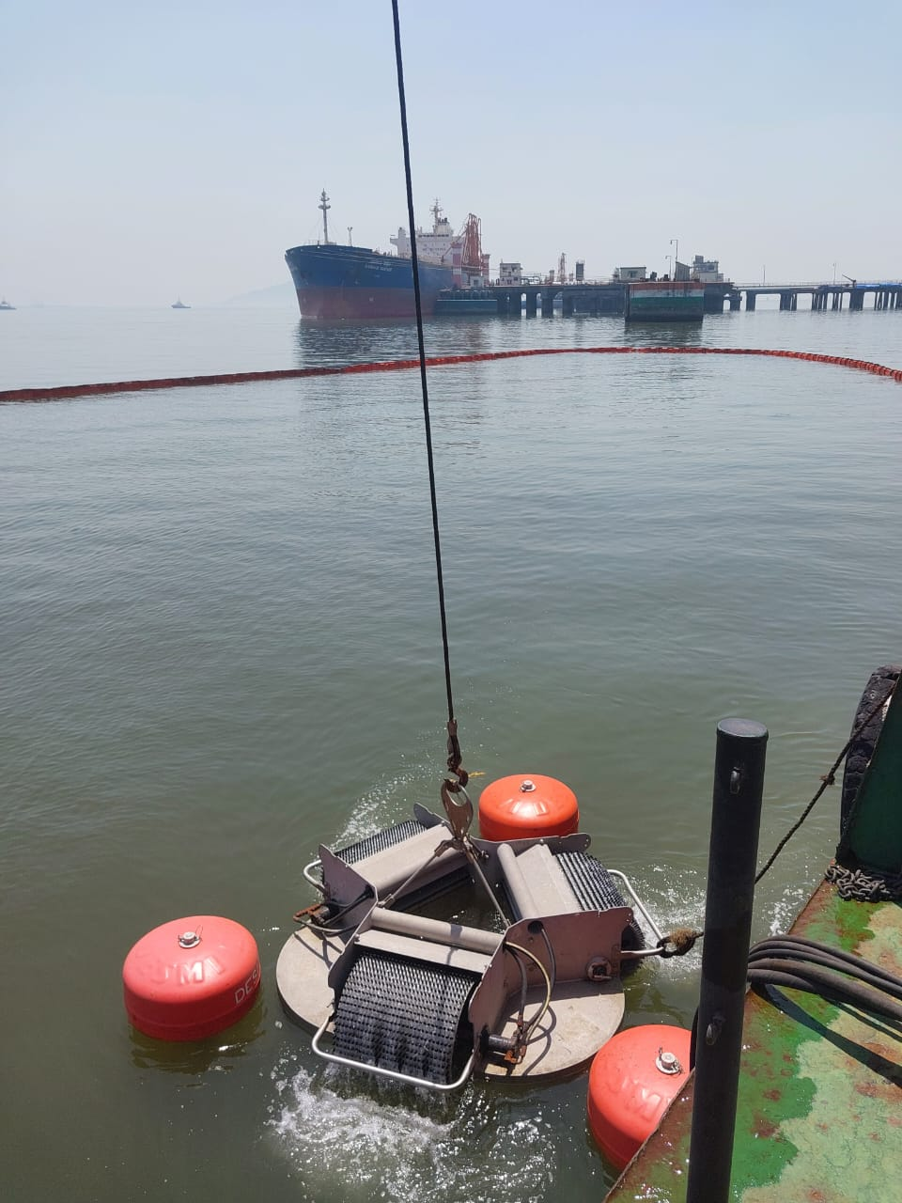
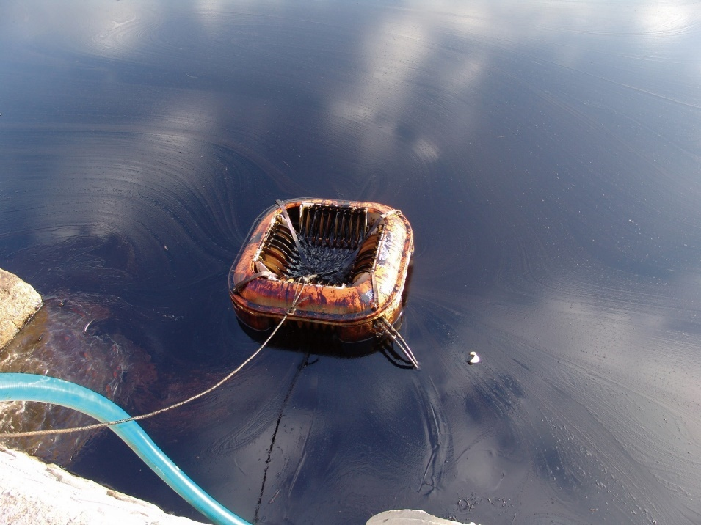
Recovery Devices
Source: ELASTEC
CGPRT(W) : Ensuring Clean Seas and Coasts in Western Region ……

Slide 30
Recovery Devices
Diverse range of devices available
Generally fall into one of four main categories, although some incorporate dual features:
Weir devices
Adhesion devices
Induction devices
Devices using other principles
CGPRT(W) : Ensuring Clean Seas and Coasts in Western Region ……

Slide 31
Recovery Devices
On water single- or multi-vessel operations
Generally a low height of eye so need guidance from above or specialized location devices
Usually limited to daylight hour operations so need to be in position before first light to maximize recovery time
Transit speeds, including course changes and 180⁰ reversals with booms deployed is low
CGPRT(W) : Ensuring Clean Seas and Coasts in Western Region ……

Slide 32
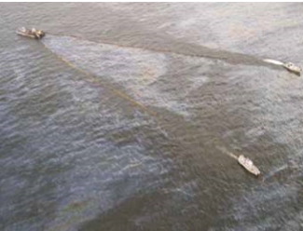
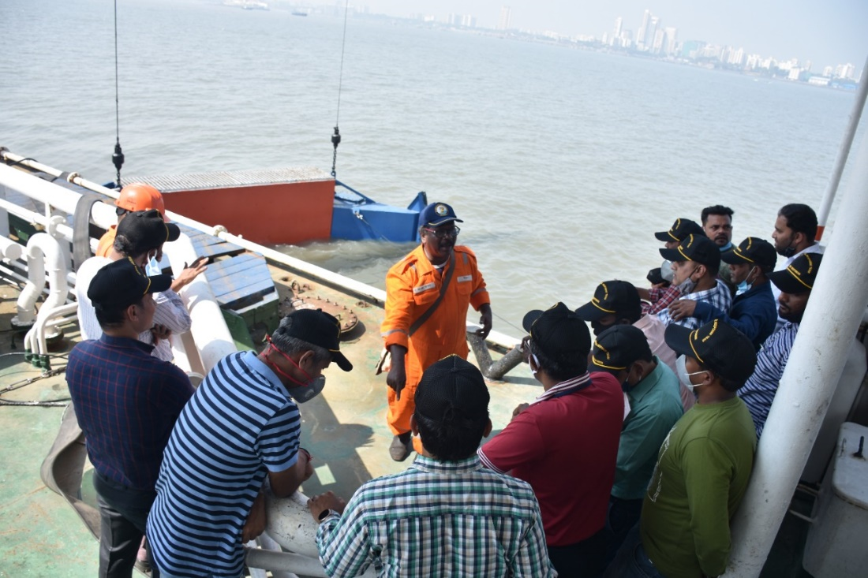
Recovery Devices
On water single- or multi-vessel recovery operations
Source : ITOPF
CGPRT(W) : Ensuring Clean Seas and Coasts in Western Region ……

Slide 33
Recovery Devices
A large proportion of water may be collected
Operations at night may be possible utilizing IR cameras or oil-sensing radar
The use of local resources and knowledge is highly recommended
Local water users know the local conditions and can be a very valuable resource
CGPRT(W) : Ensuring Clean Seas and Coasts in Western Region ……

Slide 34
Recovery Devices
In addition to containment devices they require pumps to move/push the recovered oil to the temporary storage area
This will require a set of support equipment with the correct connections and couplings
It is important to reduce the back-pressure in the discharge hose
Offshore recovery devices are heavy and will require lifting equipment to deploy and recover
CGPRT(W) : Ensuring Clean Seas and Coasts in Western Region ……

Slide 35
Subsea Recovery Devices
In shallow waters these can include suction pumps, airlift dredge systems or oleophillic sorbents.
Sunken vessels can be “hot-tapped” to gain access through the vessel’s hull. These systems can be diver- or ROV-operated, generally by salvors.
Deep-sea release containment involves the use of a “capping stack” to gain control of a blown-out well. A number of these devices are available world-wide.
CGPRT(W) : Ensuring Clean Seas and Coasts in Western Region ……

Slide 36
Safety
There are a number of safety concerns that should be addressed by risk assessment
These include:
Type of oil and associated hazards
Working near water
Working on decks covered with oil
Weather conditions and movement of vessel
An operational plan must be provided for each vessel detailing its specific operations, including risk assessments
CGPRT(W) : Ensuring Clean Seas and Coasts in Western Region ……

Slide 37
Temporary Storage
Temporary storage is critical for ongoing operations
This may consist of:
Vessel tanks
Barges
Towable tanks
When using chartered vessels not constructed as Tankers special considerations need to be given to storing and handling recovered oil
CGPRT(W) : Ensuring Clean Seas and Coasts in Western Region ……

Slide 38
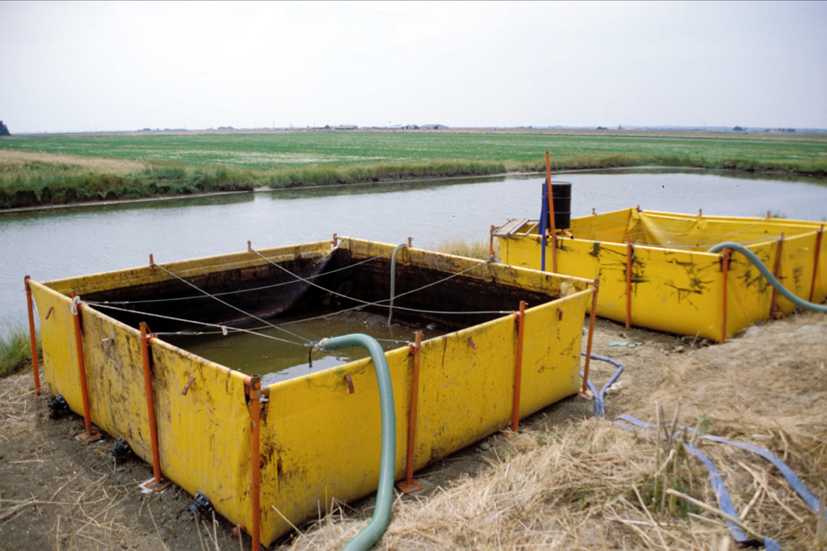
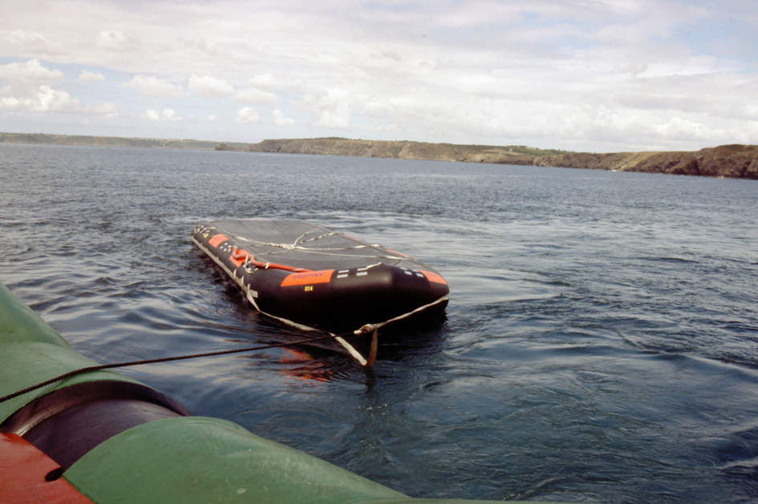
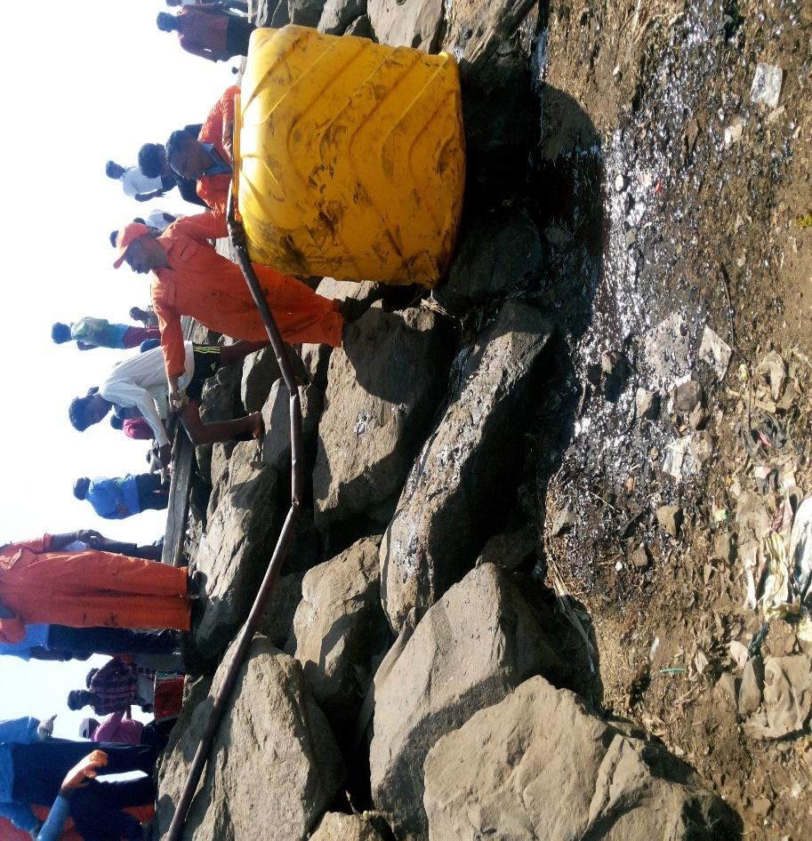
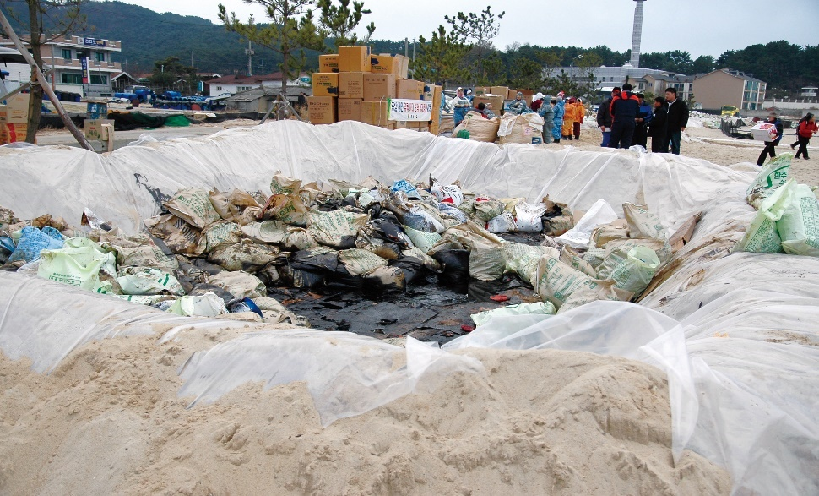
Temporary Storage
Source:CEDRE
Source:CEDRE
CGPRT(W) : Ensuring Clean Seas and Coasts in Western Region ……

Slide 39
Temporary Storage
When providing temporary storage ensure there will be sufficient capacity for ongoing operations
Consider how the recovered oil will be discharged from the storage tank
Consider the use of heating coils for viscous or cold recovered oil
Consider the use of oily water separators to reduce the amount of recovered water
Discuss a possible dispensation from the MARPOL regulations with the Administration in respect of decanting operations
CGPRT(W) : Ensuring Clean Seas and Coasts in Western Region ……

Slide 40
On Completion
Consideration should be given to:
How and where the vessels will be cleaned before being re-deployed or taken off charter
The organisation of the temporary cleaning area, including:
any permits
booming and containment
provision of personnel and materials
provision of lifting equipment or small craft
The recovery, capture and disposal of any waste
CGPRT(W) : Ensuring Clean Seas and Coasts in Western Region ……

Slide 41
Salvage Considerations
CGPRT(W) : Ensuring Clean Seas and Coasts in Western Region ……

Slide 42
Introduction
There are a number of reasons why oil can be lost from a vessel:
Collision
Grounding
Striking a wreck or other obstacle
Fire and/or explosion
Machinery or structural failure
Storm or ice damage
Flooding
Sabotage
CGPRT(W) : Ensuring Clean Seas and Coasts in Western Region ……

Slide 43
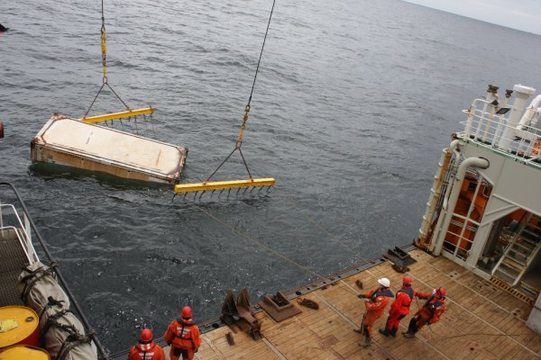
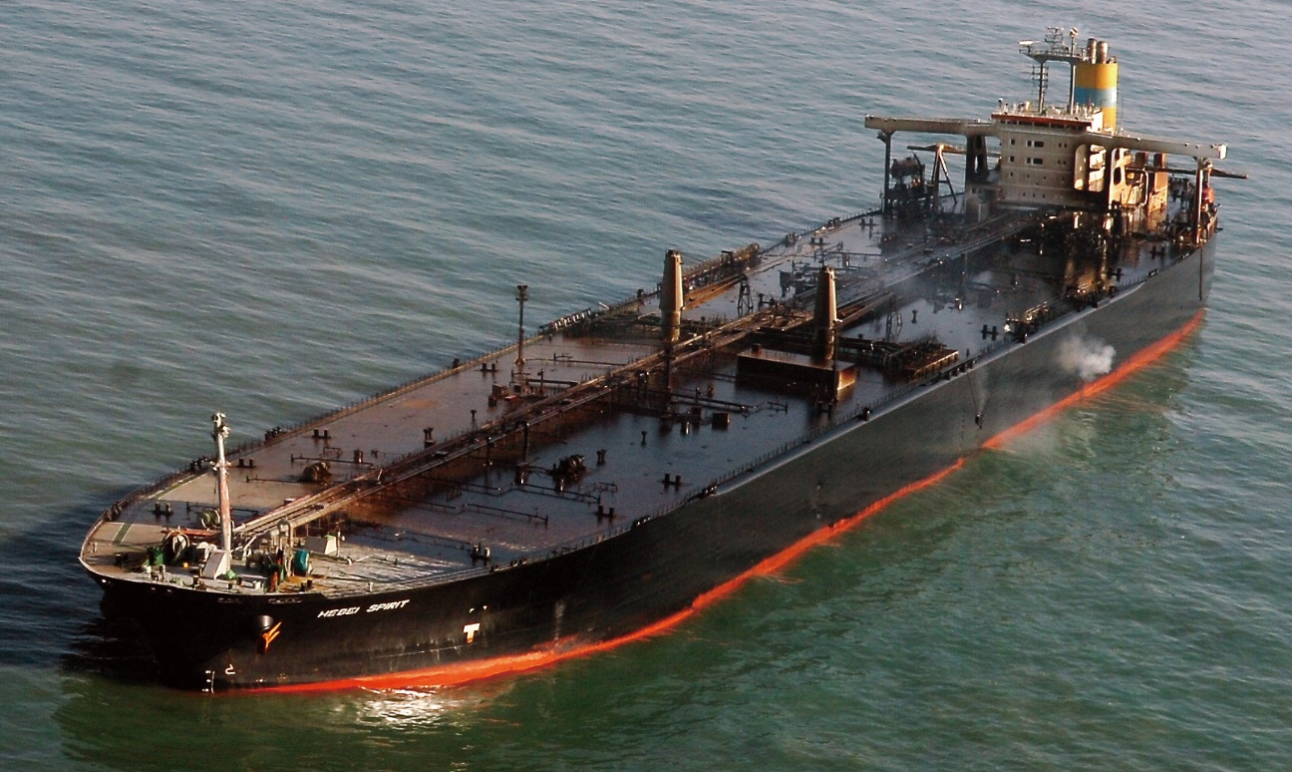
Incidents
CGPRT(W) : Ensuring Clean Seas and Coasts in Western Region ……

Slide 44
Introduction
The Master, as representative of the vessel, and cargo owners will take immediate action to ensure the:
Safety of the crew
The preservation of the ship
The preservation of the cargo
Stopping or limiting of the cargo loss
The Master may require specialist help for the salvage of the vessel
CGPRT(W) : Ensuring Clean Seas and Coasts in Western Region ……

Slide 45
Introduction
Salvage assistance will generally be arranged, on commercial terms, with a professional salvage company
In respect of tankers the salvage company is rewarded for operations, including preventative measures, that prevent or minimize pollution damage
The salvor’s primary aim will be the successful completion of his assignment in a timely fashion
CGPRT(W) : Ensuring Clean Seas and Coasts in Western Region ……

Slide 46
Introduction
An Administration, under its national law or under the Intervention Convention, may take powers to intervene when their waters or coastline are under threat from pollution
The salvage operation will be conducted between the owner/operator and salvor with both parties complying with the requirements of the Administration
It is important that there is full cooperation between all parties
CGPRT(W) : Ensuring Clean Seas and Coasts in Western Region ……

Slide 47
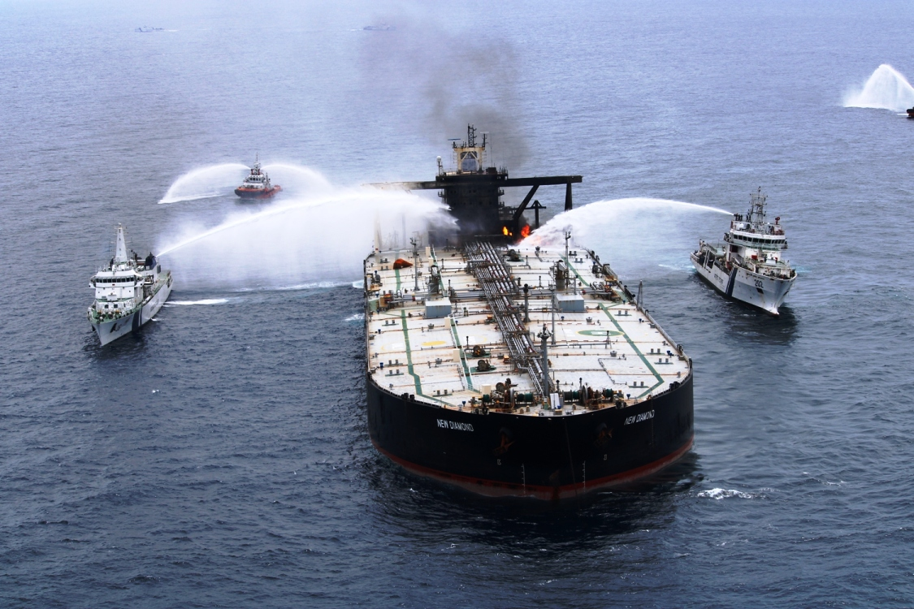
Emergency Response
Emergency response and follow-up actions:
Lightering
Cargo or bunker transfer
Towage
Shelter or re-floating
Salvage
Re-floating or wreck removal
Pollution combating
Protection of local population
CGPRT(W) : Ensuring Clean Seas and Coasts in Western Region ……

Slide 48
Response
Is intervention at sea the best option?
Balance the opportunity to prevent the oil leaving the vessel against the possible consequences:
Risk to human health and safety
Damage to vessel and cargo
Damage to the environment
Administrations are urged not to unreasonably deny access to sheltered waters
CGPRT(W) : Ensuring Clean Seas and Coasts in Western Region ……

Slide 49
Response
Is it possible?
If intervention at sea is desirable:
Can it be done?
Is the expertise available?
Is the equipment available?
Your contingency planning should address these questions
CGPRT(W) : Ensuring Clean Seas and Coasts in Western Region ……

Slide 50
Incident Command
Within the Command Function the salvage response should focus on:
Notifying the relevant authorities
Establishing the facts and assessing the damage potential of the incident
Establishing and maintaining contact with all parties concerned
Shipowner, cargo owner, salvors, insurance interests, classification society, Flag State
CGPRT(W) : Ensuring Clean Seas and Coasts in Western Region ……

Slide 51
Incident Command
Decide whether salvage activities being undertaken by the owner are adequate
Decide what additional steps the Command Function can take to facilitate salvage and prevent pollution
CGPRT(W) : Ensuring Clean Seas and Coasts in Western Region ……

Slide 52
Incident Command
Organize the prompt availability of specialist assistance and salvage materials
This may include assistance with Customs, Immigration or logistical facilitation
This may include the provision of government equipment, access to government stockpiles or response assistance
CGPRT(W) : Ensuring Clean Seas and Coasts in Western Region ……

Slide 53
Incident Command
Review and approve, as appropriate, the salvage plan including the appropriate risk assessments for the proposed operations
Consider “Places of refuge” to facilitate the salvage operations
Impose and enforce Temporary Exclusion Zones and Temporary Danger Areas
Ensure close cooperation between the salvage operation and the Operations and Planning functions
CGPRT(W) : Ensuring Clean Seas and Coasts in Western Region ……

Slide 54
Salvage Operations
Salvage is a highly technical and complex process which, where possible, is best conducted by professional salvors
These salvors may need further specialist expertise such as from the offshore industry to respond to pipeline and offshore installations
In the same manner that Search and Rescue (SAR) operations may be conducted alongside the incident response, both SAR and salvage operations are critical components of the overall response
CGPRT(W) : Ensuring Clean Seas and Coasts in Western Region ……

Slide 55
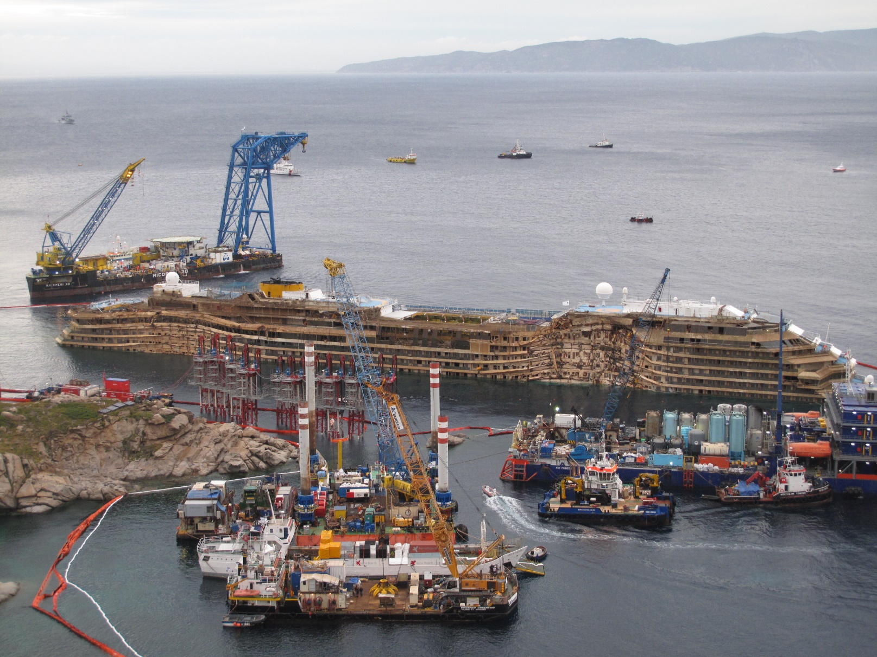
Salvage Operations
CGPRT(W) : Ensuring Clean Seas and Coasts in Western Region ……

Slide 56
Salvage Operations
Some common salvage methods are:
Lightering
The transfer of cargo or bunkers to a suitable vessel or ashore in order to lighten the vessel
May also include the internal transfer of cargo to minimize or reduce the risk of fire, explosion or pollution
Air Lift
Displacement of water by air pressure, especially where tanks have been opened to the sea.
All tank opening needs to be sealed to withstand the pressure increase
If possible move cargo or bunkers to minimize any pollution
CGPRT(W) : Ensuring Clean Seas and Coasts in Western Region ……

Slide 57
Salvage Operations
Some common salvage methods are:
Tidal lift and heaving
This method uses the power of the rising tide to assist in re-floating but may require heavy “beach gear” consisting of anchors, wires, etc.
Towing
Relies on the pulling power of salvage vessels or tugs
This requires appropriate towing lines and securing points on the casualty
SOLAS requires tankers to be fitted with appropriate emergency towing facilities
Local tidal knowledge is very important to ensure that the pulling forces are applied in the most effective direction
CGPRT(W) : Ensuring Clean Seas and Coasts in Western Region ……

Slide 58
Salvage Operations
Some common salvage methods are:
Re-floating or breaking out stranded vessels
Re-floating relies on overcoming the downward force exerted by the stranded vessel on the sea bed
This could be by reducing the weight of the stranded vessel by lightering
This could be by increasing the floating force by using pontoons, barges or air bags
This could be by excavating the ground beneath the stranded vessel
CGPRT(W) : Ensuring Clean Seas and Coasts in Western Region ……

Slide 59
Salvage Operations
Some common salvage methods are:
Capping and containment of offshore pipework
Specialized capping devices installed using specialized subsea operations vessels and ROVs
CGPRT(W) : Ensuring Clean Seas and Coasts in Western Region ……

Slide 60
Salvage Equipment
In every case specialized expertise and knowledge will be required
This may be a combination of salvage experience and knowledge of the local conditions
Often specialized equipment needs to be brought to the site
This can take time during which the stranded vessel will be exposed to the sea and weather
In some cases the vessel may be deliberately stranded awaiting the equipment
CGPRT(W) : Ensuring Clean Seas and Coasts in Western Region ……

Slide 61
Salvage Process
Salvors will carry out inspections, including diving inspections, to ascertain the current condition of the vessel
Damage control measures may be put in place to prevent any further deterioration or movement
The salvage plan will be drawn up in consultation with naval architects and the shipowners or operators
Normally this salvage plan will be discussed and agreed with the Administration and Incident Command
CGPRT(W) : Ensuring Clean Seas and Coasts in Western Region ……

Slide 62
Response – Evaluation
Place an evaluation team on board:
Experienced personnel equipped with appropriate personal protective equipment
Ascertain full status of the vessel
Cargo, bunkers and disposition
equipment and facilities on board
operational status of machinery, etc.
Carry out risk assessment
CGPRT(W) : Ensuring Clean Seas and Coasts in Western Region ……

Slide 63
Place of Refuge Considerations
The assessment process
Likelihood/Consequence matrix
Risk register
The resources and expertise available
Procedures for decision-making
Procedures for international coordination
Financial guarantee and liability procedures
CGPRT(W) : Ensuring Clean Seas and Coasts in Western Region ……

Slide 64
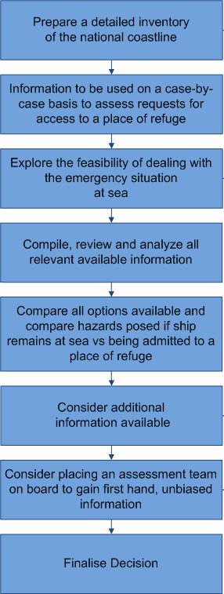
Place of Refuge
Decision-making process Source: REMPEC SAFEMED Project 2005/109-573
CGPRT(W) : Ensuring Clean Seas and Coasts in Western Region ……

Slide 65
Likelihood/Consequence Matrix
Example
Likelihood | Consequence
 | Insignificant | Minor | Moderate | Major | Catastrophic
Almost Certain (>90% chance) | High | High | Extreme | Extreme | Extreme
Likely (50% ~ 90% chance) | Moderate | High | High | Extreme | Extreme
Moderate (10% ~ 50% chance) | Low | Moderate | High | Extreme | Extreme
Unlikely (3% ~ 10% chance) | Low | Low | Moderate | High | Extreme
Rare (<3% chance) | Low | Low | Moderate | High | High
CGPRT(W) : Ensuring Clean Seas and Coasts in Western Region ……

Slide 66
Risk Register − Example
ID | Risk | Consequence | Consequence
 |  | Remain in Situ | Place of Refuge
1 | Crew Safety | High | Low
2 | Responder/Salvor Safety | High | Low
3 | Public Safety | Low | Medium
4 | Pollution – Cargo | High | Low
5 | Pollution - Bunkers | High | Medium
6 | Navigational Safety | Low | Low
7 | ………………..
8 | ………………..
CGPRT(W) : Ensuring Clean Seas and Coasts in Western Region ……

Slide 67
Incident Management
Command Function
Planning Function
Logistics
Function
Finance Function
Operations Function
Response
Planning
Salvage
Operations
CGPRT(W) : Ensuring Clean Seas and Coasts in Western Region ……

Slide 68
Incident Command
Let us discuss where salvage operations fit into IMS
Consider this:
If salvage operations are being conducted within the Incident Command then does participation within the Operations and Planning Functions seem appropriate?
If salvage operations are being conducted outside of the Incident Command then consider liaison into the Command Function and participation within the Planning Function
Consider the Coordinated Command model
How will you integrate salvage operations?
CGPRT(W) : Ensuring Clean Seas and Coasts in Western Region ……

Slide 69
Any questions?
CGPRT(W) : Ensuring Clean Seas and Coasts in Western Region ……

